Slide 2
Matters in Discussion
Role of people involved
French property purchases
French estate planning
… and a few developments in Europe …
www.ashtonslegal.co.uk
www.heslop-platt.co.uk

Slide 3
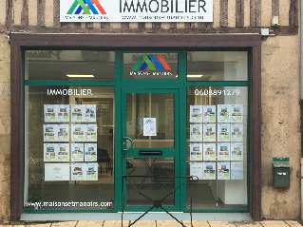
Role of People Involved
Surveyors
The agent
The notaire.
www.ashtonslegal.co.uk
www.heslop-platt.co.uk

Slide 4
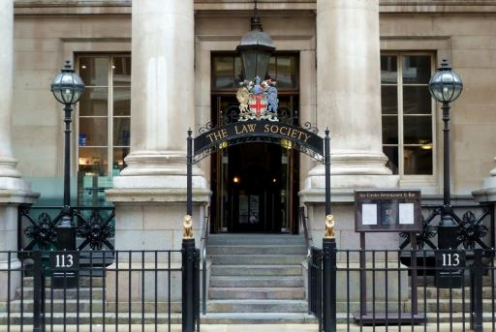
People Involved…
The solicitor
www.ashtonslegal.co.uk
www.heslop-platt.co.uk

Slide 5
Issues on Purchase
Contract
Who drafts?
Most commonly compromis de vente
Conditional contracts
Signed very soon
2 – 3 months to complete.
www.ashtonslegal.co.uk
www.heslop-platt.co.uk

Slide 6
Standard Conditions
Clear mortgage register
No pre-emption rights
No adverse planning restrictions
Buyer’s mortgage requirement.
www.ashtonslegal.co.uk
www.heslop-platt.co.uk

Slide 7
Possible Conditions
Survey?
Sale of existing property?
Planning issues?
Buyers alive on completion.
www.ashtonslegal.co.uk
www.heslop-platt.co.uk

Slide 8
Completion
Provision and approval of Acte de Vente
Attendance
Payment
Registration
Attestation.
www.ashtonslegal.co.uk
www.heslop-platt.co.uk

Slide 9
Property and Other Taxes
Local taxes
Capital gains tax
Wealth tax
Income tax.
www.ashtonslegal.co.uk
www.heslop-platt.co.uk

Slide 10
Estate Planning
Inheritance rules – rights of children, spouse
The ‘old rules’ can apply – if suitable for you
Joint Ownership
en indivision
en tontine
Company
Wills – French? English? One of each?
www.ashtonslegal.co.uk
www.heslop-platt.co.uk

Slide 11
EU Succession Regulation
Enables a person to choose the law of nationality
UK has not ratified the Regulation
Tax position is not affected
Departure from EU will not change position
Should French or English (or Scottish or other) law apply?
Inheritance law is not necessarily governed by the form of a Will.
www.ashtonslegal.co.uk
www.heslop-platt.co.uk

Slide 12
Succession Issues
Successions to be completed under French or English (or other) rules?
Domicile
France and trusts.
www.ashtonslegal.co.uk
www.heslop-platt.co.uk

Slide 13
Inheritance tax issues
Tax position not changed by Regulation
Tax is personal to beneficiary
Time for payment – 6 months, 12 months
Double tax treaty.
www.ashtonslegal.co.uk
www.heslop-platt.co.uk

Slide 14
Rates of Tax – in France
Personal allowances and taxes vary
Allowances: 1,594€ to 100,000€
Tax rates: 5% up to 60%
Spouse / PACS / CPA exemption
And UK tax?
www.ashtonslegal.co.uk
www.heslop-platt.co.uk

Slide 15
Legal Developments
Social Charges
Brexit.
www.ashtonslegal.co.uk
www.heslop-platt.co.uk

Slide 16
If you would like more information on any of the topics discussed, please
visit us on Stand 32.
france@ashtonslegal.co.uk
0800 915 6037
contact@heslop-platt.co.uk
0113 393 1930
Offices in Bury St Edmunds, Cambridge, Ipswich, Norwich and Leeds
www.heslop-platt.co.uk

